Slide 1
The Affordable Connectivity Program (ACP)
Notes:
-add slide numbers

Slide 2

What is the Affordable Connectivity Program?
A Federal Communications Commission (FCC) program that helps connect families and households struggling to afford internet service
Helps many low-income households afford internet service and devices (laptop or tablet)
Provides ongoing monthly internet discount
Slide 2
Notes:
David
References:
- https://documentcloud.adobe.com/spodintegration/index.html?r=1&locale=en-us
- https://acpbenefit.org/
- http://www.seattle.gov/tech/services/internet-access/affordable-connectivity-program-(acp)
- https://techtalk.seattle.gov/2022/02/28/affordable-connectivity-program-acp-helping-low-income-households-with-internet-costs/

Slide 3

The benefit provides:
Up to $30/month discount for internet services
Up to $75/month discount for households on qualifying Tribal lands
A one-time discount of up to $100 for a device purchased through some participating providers (if the provider you’re getting service from is offering devices)
Slide 3
Notes:
David
References:
-flyer via email from David

Slide 4
Home internet providers
Providers on the ACP in Seattle
Mobile internet providers (partial list)
PCs for People*
Human-I-T*
AT&T
T-Mobile via Assurance Wireless
Verizon
Comcast (Xfinity)*
Astound (formerly Wave)
Lumen (formerly CenturyLink)
* = direct signup and equipment options
Note: Comcast only offers lower-cost device with Internet Essentials signup
Slide 4
Notes:
David
References:
- http://www.seattle.gov/tech/services/internet-access/affordable-connectivity-program-(acp)#whatprovidersareontheaffordableconnectivityprogramacpinseattleandkingcounty
-comcast isn’t offering the laptops or tablets at this time (for the ACP)
-both comcast and astound offer a $10/month option while Lumen doesn’t

Slide 5
Who is eligible for the ACP?
A household is eligible if one member of the household:
Participates in certain assistance programs
SNAP, Medicaid, Federal Public Housing Assistance, SSI, WIC, or Lifeline
Participates in Tribal specific programs
Is approved to receive benefits under the free and reduced-price school breakfast/lunch program
Received a Federal Pell Grant during the current award year
Slide 5
Notes:
References:
- https://techtalk.seattle.gov/2022/02/28/affordable-connectivity-program-acp-helping-low-income-households-with-internet-costs/
A household is eligible if one member of the household
Participates in certain assistance programs (SNAP, Medicaid, Federal Public Housing Assistance, SSI, WIC, or Lifeline)
Participates in Tribal specific programs (Bureau of Indian Affairs General Assistance, Tribal TANF, or Food Distribution Program on Indian Reservations)
Is approved to receive benefits under the free and reduced-price school lunch program or the school breakfast program, including through the USDA Community Eligibility Provision
Received a Federal Pell Grant during the current award year
Eligible for existing low-income A household is eligible if one member of the household

Slide 6
Low-income Guidelines
Household Size | 48 Contiguous States, D.C., and Territories
1 | $27,180
2 | $36,620
3 | $46,060
4 | $55,500
5 | $64,940
6 | $74,380
7 | $83,820
8 | $93,260
For each additional person, add: | $9,440
Applicants are eligible for the ACP if their income is 200% or less than these Guidelines. The guideline is based on your household size.
Slide 6

Slide 7
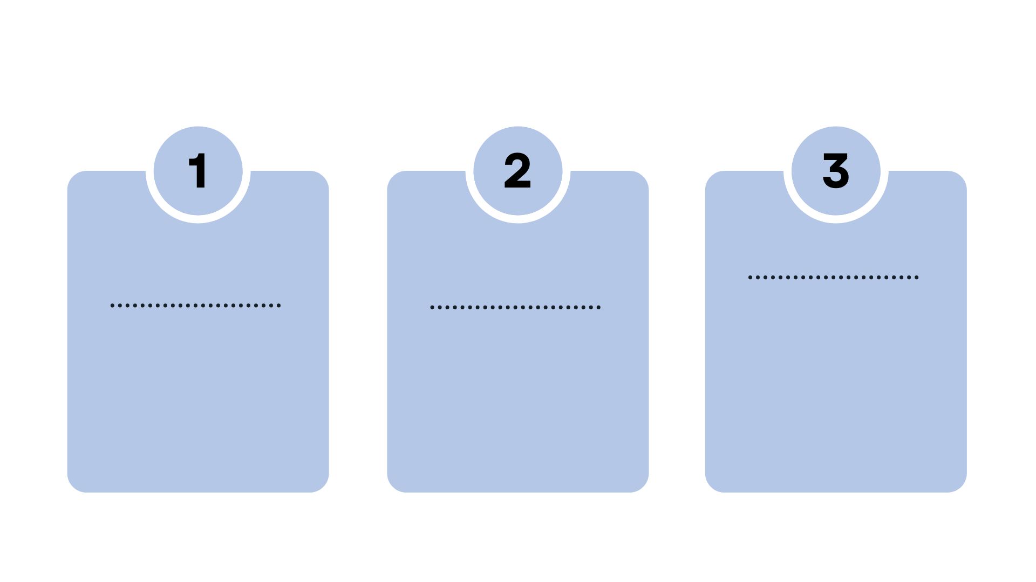
Types of Applicants
New to the low-income program
Currently in a low-income internet program
Lifeline Subscriber
Automatically eligible
Can get their internet eligibility number from Lifeline
Can enroll with their current or new internet provider
Already has an internet subscription
Has no internet service
Can sign-up for ACP directly with Comcast, PCs for People, or Human-I-T
For Astound (Wave), applicant will also have to do federal application
Slide 7

Slide 8
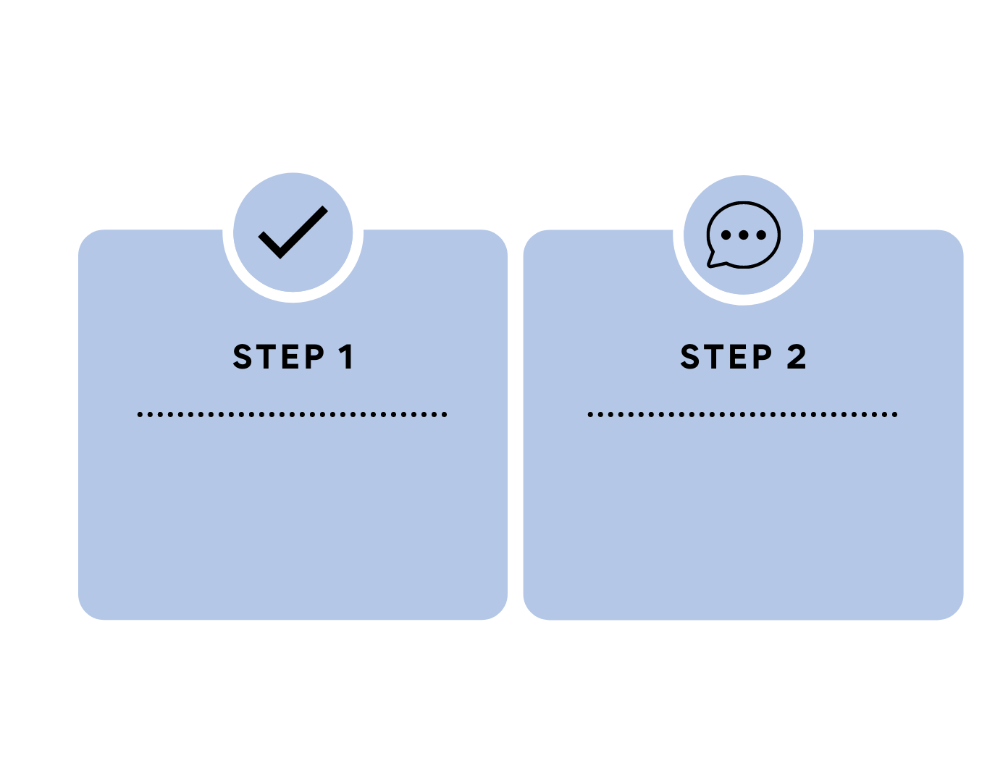
How do I apply for the ACP?
Note: Internet providers with residents on a low-income program allow direct ACP sign-up.
Fill out an application online or download and print an application to mail in
Visit ACPbenefit.org to verify eligibility
Verify eligibility at
GetEmergencyBroadband.org
Slide 8
Notes:
Slide before:
Some internet providers with a low-income program allow direct ACP sign-up while others require the federal ACP eligibility sign-up first
STEP 1: Visit acpbenefit.org
STEP 2: Fill out application online or download and print an application to mail in

Slide 9
Tips
Look over Documentation Guidelines to ensure applicants have documents needed to apply
Applicants will need an email address to apply online
Mail-in option is available for the application
Applicants can use an alternate ID if they’re not a citizen
Watch for any predatory marketing
ISPs are adapting their offerings to the Federal Benefit (e.g. Comcast has two tiers of Internet Essentials)
May be helpful for applicants to apply their benefit to a second connection
Be patient and understanding of applicants’ situation
Slide 9

Slide 10
Pricing
Company | Lowest Tier | Second Tier | Third Tier
Comcast | $19.99 for 50 Mbps | $39.99 for 100/5 Mbps | $49.99 for 300 Mbps
Astound | $19.95 for 100 Mbps | $39.95 for 500 Mbps | $49.95 for 940 Mbps
Internet Essentials by Comcast/Xfinity and Simply Internet by Astound/Wave offer programs at $9.95 with 50 Mbps.
Slide 10

Slide 11
Quick links and additional resources
ACP application link: www.ACPBenefit.org
Application forms: https://acpbenefit.org/help/resources/
FCC's ACP page: www.fcc.gov/acp
For application questions: ACPSu...@usac.org or 1-877-384-2575
To request a speaker: ACPsp...@fcc.gov
ACP Outreach Toolkit: https://www.fcc.gov/acp-consumer-outreach-toolkit
File a consumer complaint: consumercomplaints.fcc.gov
Slide 11
Notes:
Dana
References:
- https://techtalk.seattle.gov/2022/02/28/affordable-connectivity-program-acp-helping-low-income-households-with-internet-costs/

Slide 12
Thank you!
Slide 12

